Slide 1

Restaurant finder: enhanced search for restaurant features
Daniel Felker dfelker2@illinois.edu
Sanjay Babbar babbar2@illinois.edu
Meng-Yun Tsay mtsay2@illinois.edu

Slide 2
AGENDA
Installation
Setup and data prep
Usage

Slide 3
Installation

Slide 4
Installation: Setting up environment
Requirements:
Python version 3.7 with the following libraries
Flask version 2.2.2
Metapy version 0.2.13
Orjson version 3.8.2
Toml version 0.10.2
Geopy version 2.3.0
Download project from github
git clone https://github.com/fitzwolf/RestaurantFinder
Using conda the following commands create a working environment
conda create –n <name> python=3.7
conda activate <name>
pip install –r requirements.txt

Slide 5
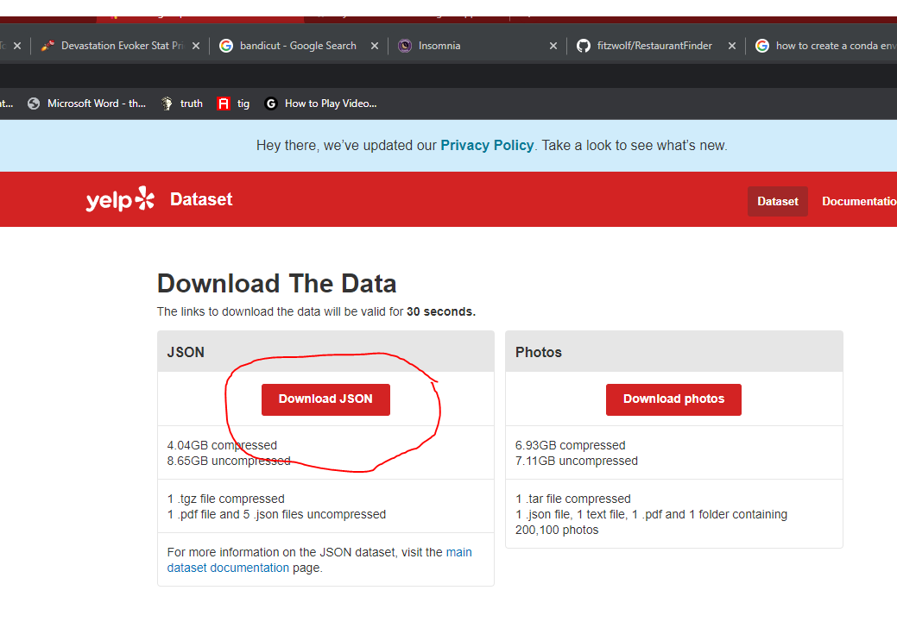
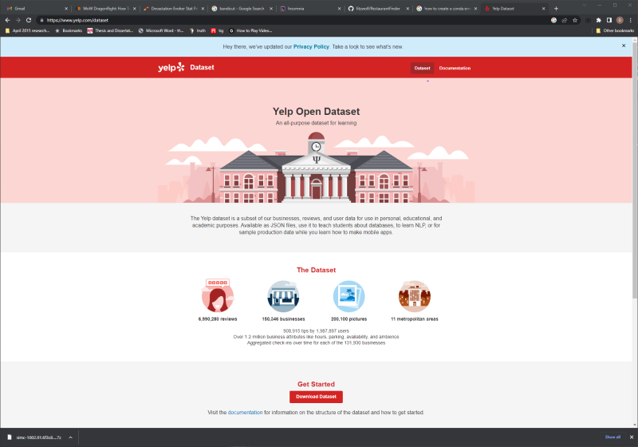
Installation: Setting up environment
Downloading academic yelp dataset and choose the json file: https://www.yelp.com/dataset

Slide 6
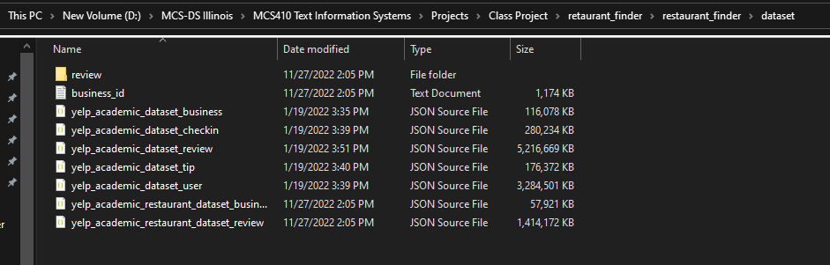
Installation: Setting up environment
Uncompress the yelp dataset and make note of it’s final location
This will be OS specific but you need this path to create our indexing
Below is an example from a Windows environment, capture the full path string and make sure you have the listed json files (as seen below).

Slide 7
Setup and data prep

Slide 8
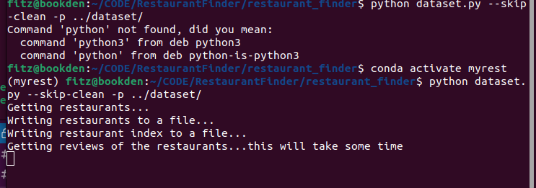
Setup and data prep - dataset
Turn Yelp dataset into a usable index, --skip-clean will keep the json files for initial install this can be useful in the event something doesn’t work
python dataset.py --skip-clean –p <path_to_dataset>

Slide 9
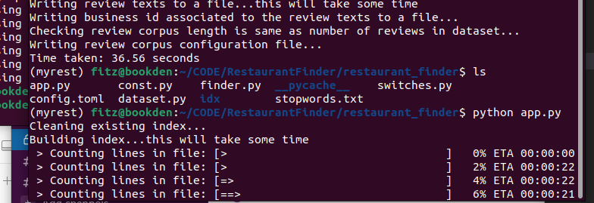
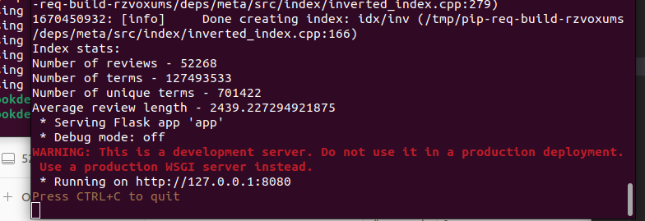
Setup and data prep - Webserver
Startup the web server app component this will take a bit of time
python app.py
Once you see the display below the app is ready to use
you can also watch this window to see what is being served
to the chrome-extension.

Slide 10
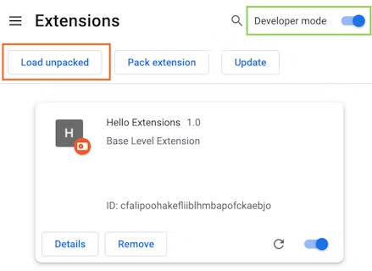
Setup and data prep – Chrome extension
Go to the Extensions page by entering chrome://extensions in a new tab.
Alternatively, click on the Extensions menu puzzle button and select Manage Extensions at the bottom of the menu.
Or, click the Chrome menu, hover over More Tools, then select Extensions.
Enable Developer Mode by clicking the toggle switch next to Developer mode.
Click the Load unpacked button and select the extension directory with the repo /Chrome-Extension

Slide 11
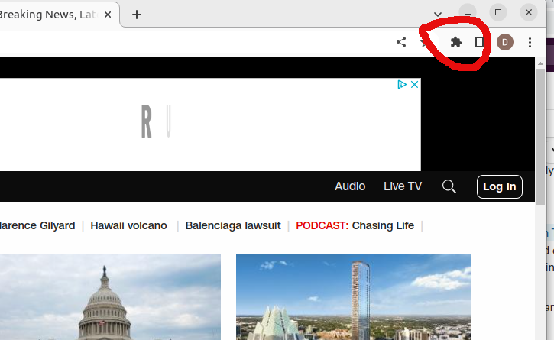
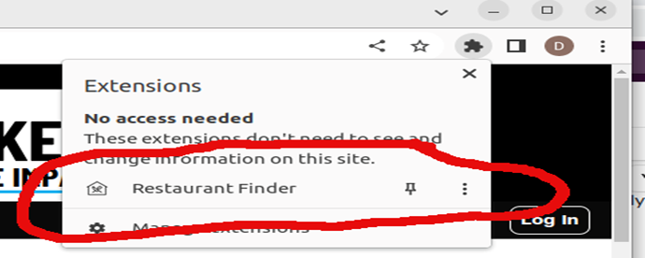
Setup and data prep – Chrome extension
Once the extension is loaded you can then either pin it to quickly click multiple times or just load it from your extensions tab (see below)

Slide 12
Usage

Slide 13
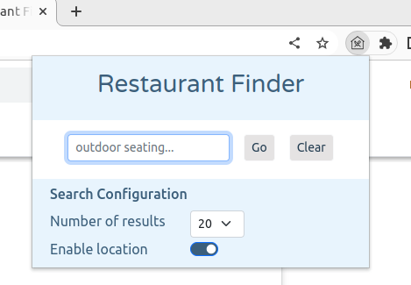
usage – Chrome extension
Assuming the app.py is still running at this point you can now either use the chrome-extension or navigate directly to index.html.
Using the chrome-extension simply click the restaurant finder icon in your extensions bar or select it from the drop down.

Slide 14
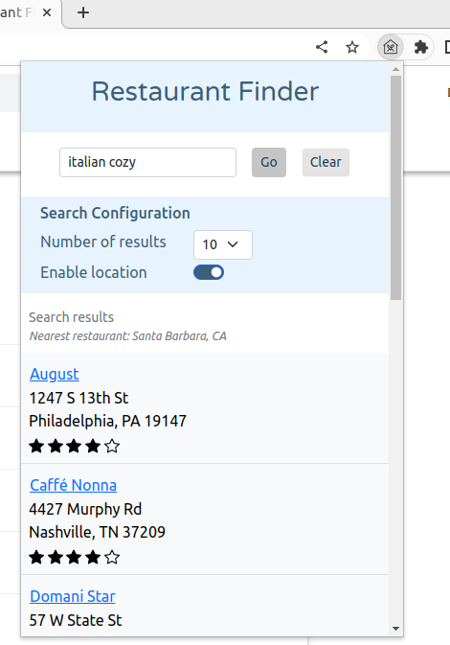
usage – Chrome extension
Enter desired text such as “cozy Italian” and it will return the best results possible.

Slide 15
THANK YOU
Daniel Felker dfelker2@illinois.edu
Sanjay Babbar babbar2@illinois.edu
Meng-Yun Tsay mtsay2@illinois.edu

